Slide 1
SLEEP HEALTH AND LIFESTYLE
BY
AKHIL KRISHNA DULIKATTA
MARY SHREEJA THUMMA

Slide 2
CONTENTS
Introduction
Objective
Goals
Dataset
Correlations
Scatter Plots
Advantages/ Disadvantages
Conclusion/ Future Scope

Slide 3

INTRODUCTION
In today’s world most of the people are affected by heart attacks.
To overcome this issue, we can predict it earlier by using Linear regression models by describing the relationship between a dependent variable Y, and one or more independent variables X.

Slide 4

OBJECTIVE
Sleep and health dataset is typically gathered to study the relationship between sleep patterns, sleep quality, and various aspects of physical and mental health.
This project is used to gain insights into sleep-related issues, develop evidence-based interventions, and ultimately promote better sleep and overall health in the population.

Slide 5
GOALS
To anticipate the heart disease at its earliest.
To analyse the data and fine which model suits better
To find the predictive models of the dataset and also the relation between them

Slide 6
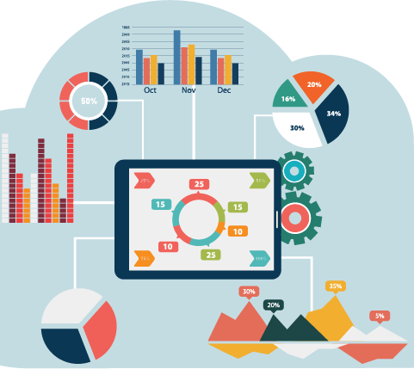
DATASET
Sleep health and lifestyle dataset consists of 374 rows and 13 variables.
The variables are
Person ID 8. Stress Level
Gender 9. BMI Category
Age 10. Blood Pressure
Occupation 11. Heart Rate
Sleep Duration 12. Daily Steps
Quality of Sleep 13. Sleep Disorder
Physical Activity Level

Slide 7

WHAT IS TO BE DONE? Data cleaning Data analysis of every factor Predictions

Slide 8
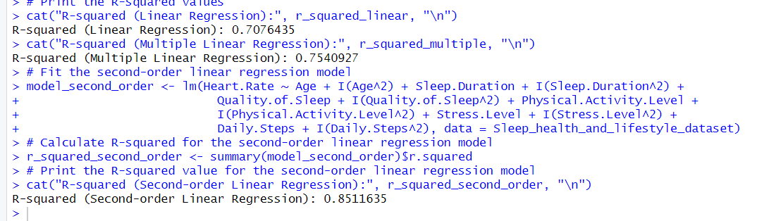
First we have to calculate which method suits better for this dataset
Calculate r^2 and see which regression model has high value

Slide 9
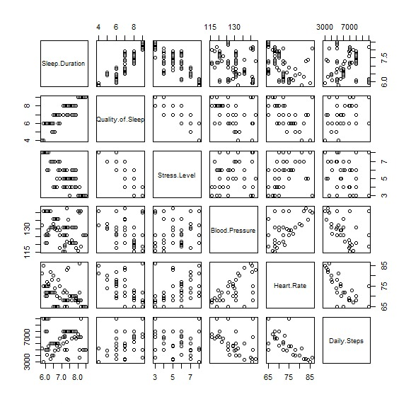
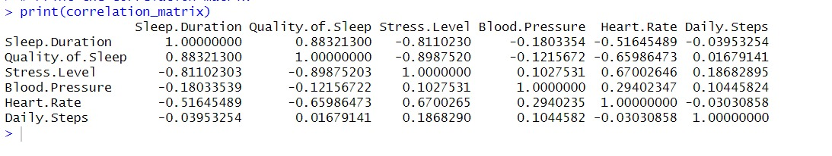
Correlation Matrix & Plot

Slide 10
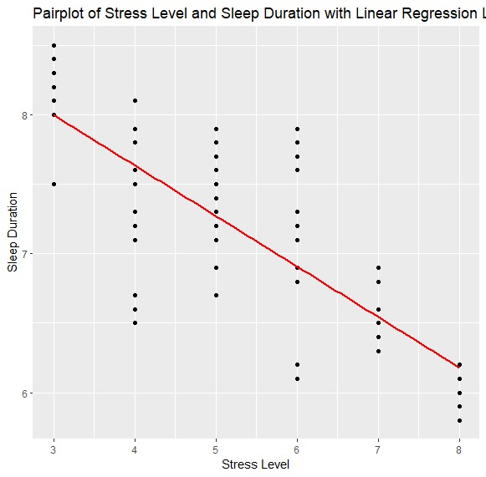
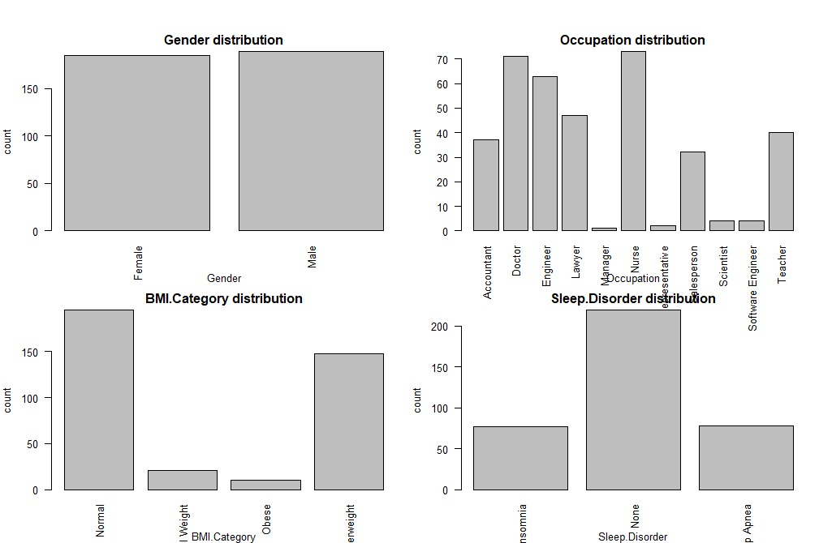
Correlation between variables

Slide 11
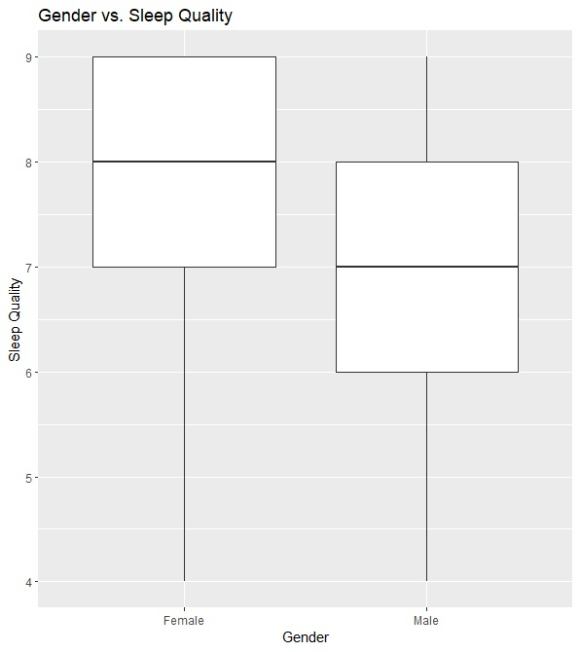
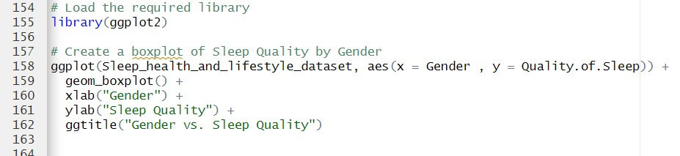
Relation between Gender and Sleep Quality

Slide 12
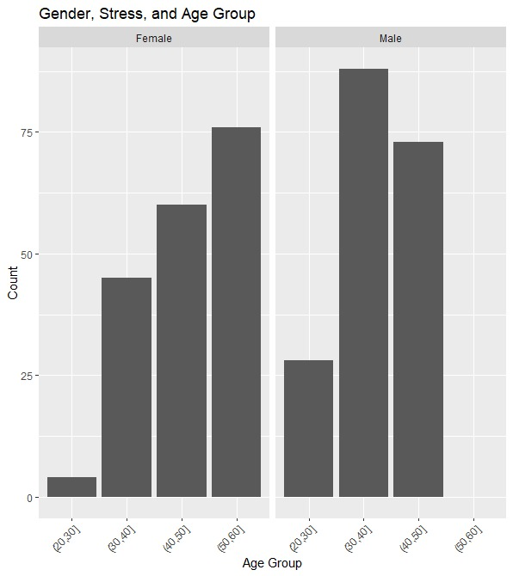
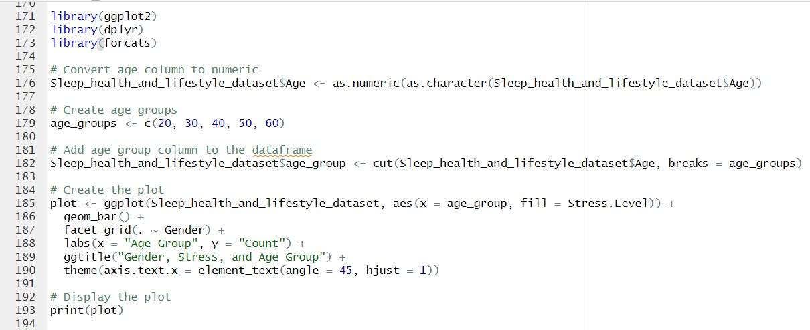
Relation between Gender, Stress Level and Age

Slide 13
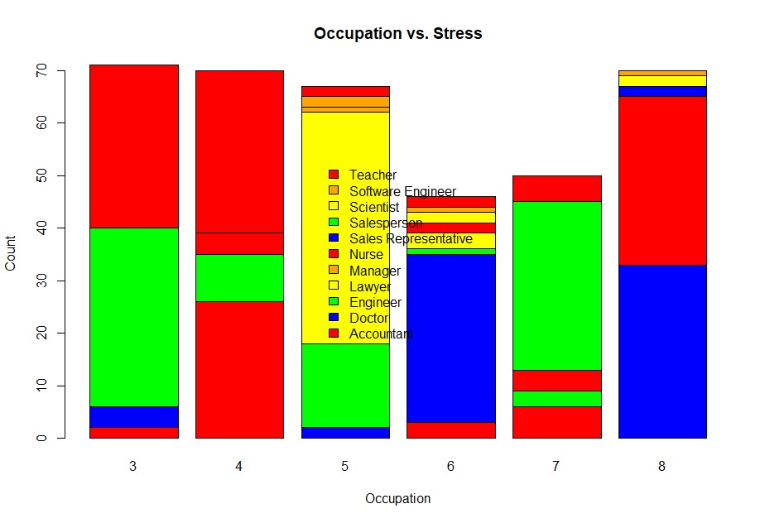
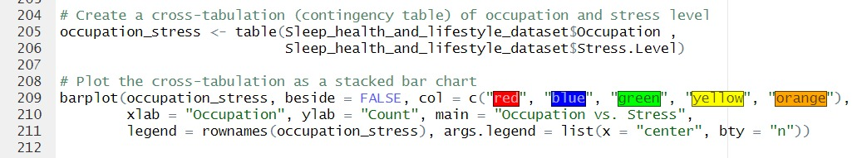
Occupation Vs Stress Level

Slide 14
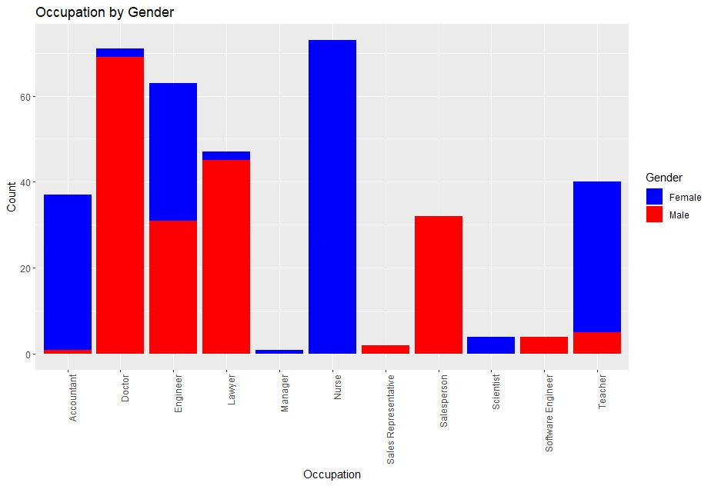
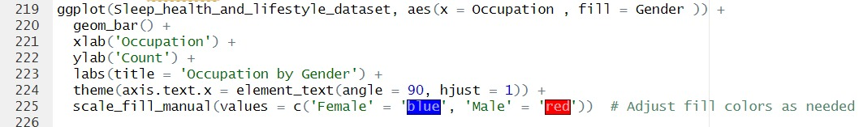
Occupation Vs Gender

Slide 15
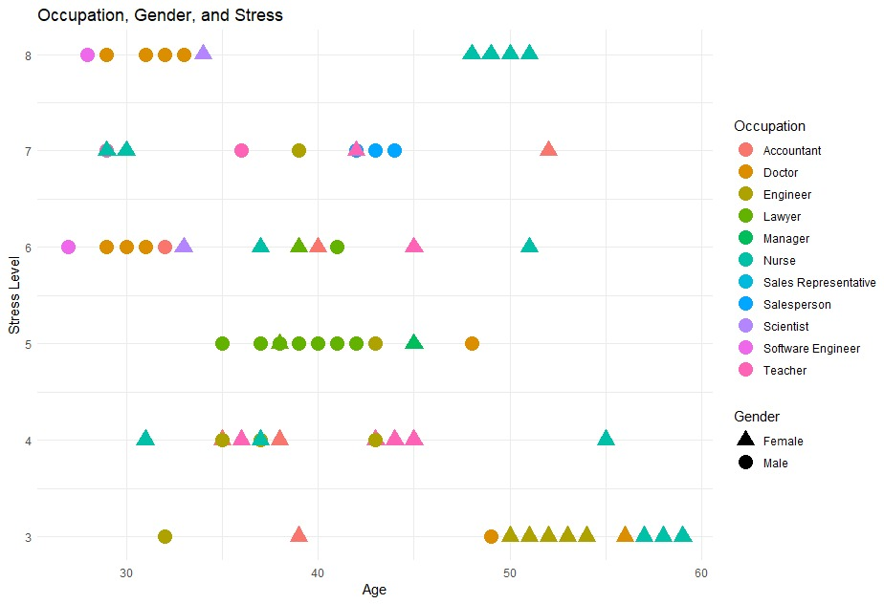
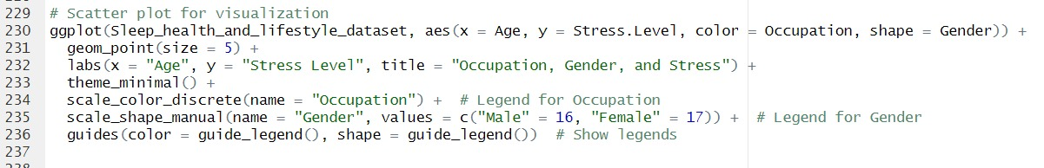
Occupation, Gender and Stress Level

Slide 16
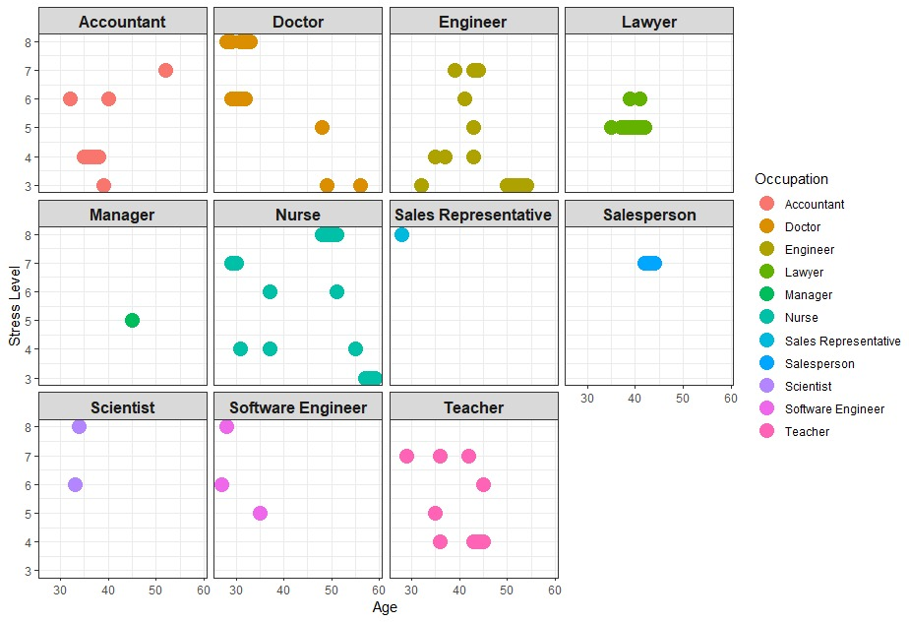
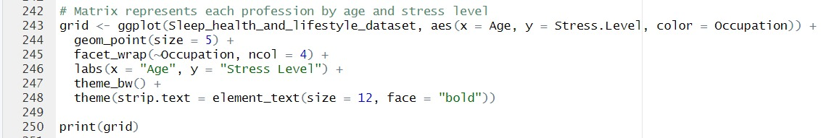
Plots by Occupation

Slide 17
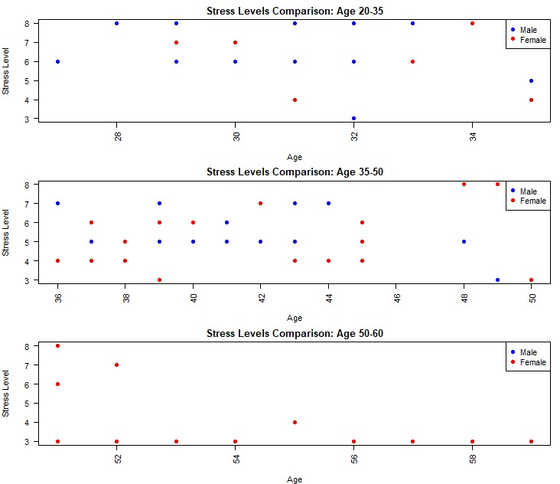
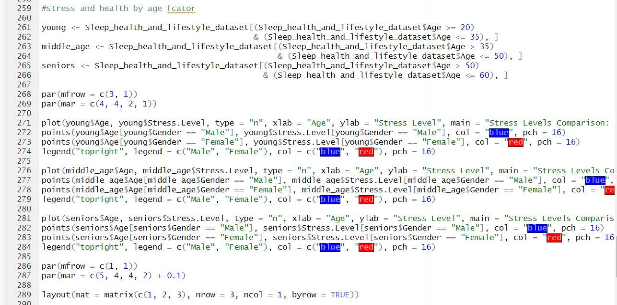
Stress Level comparison with respect to Age

Slide 18
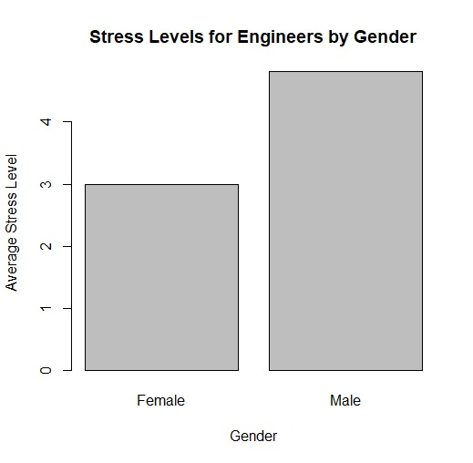
Stress Level for Engineers by Gender

Slide 19
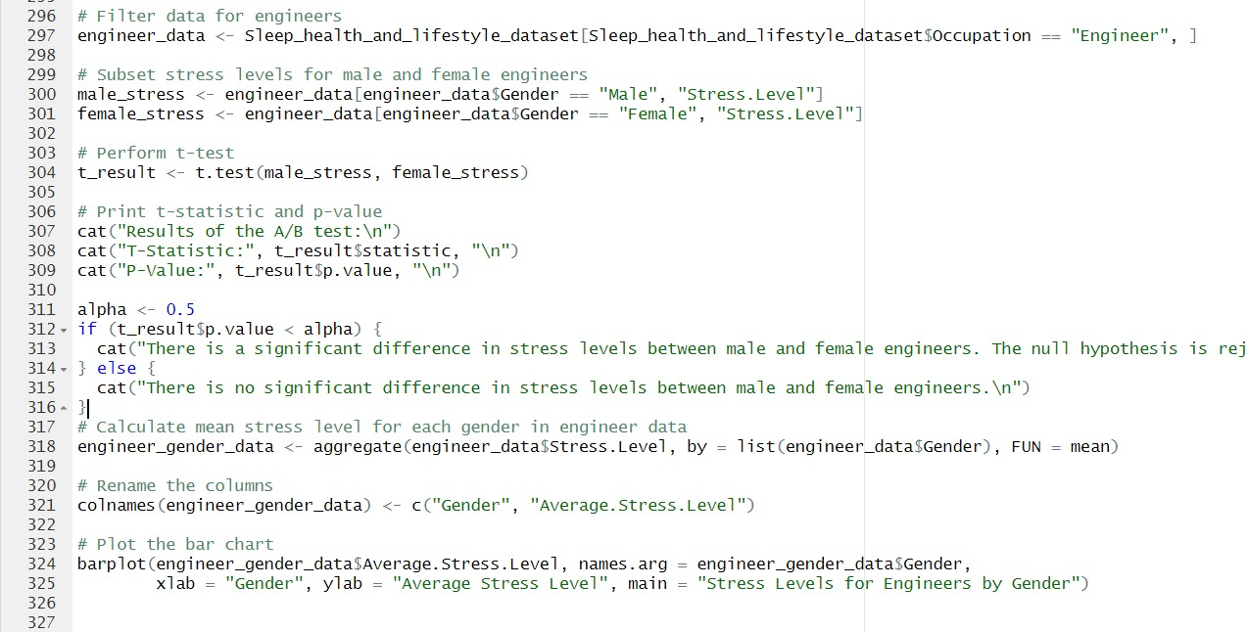
T-test

Slide 20
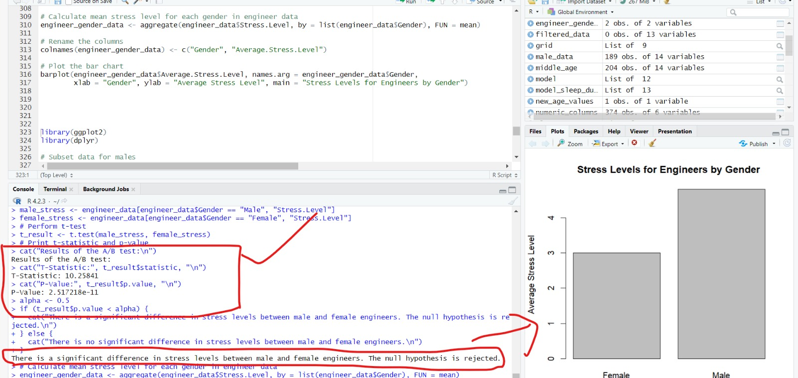
T-test Output

Slide 21
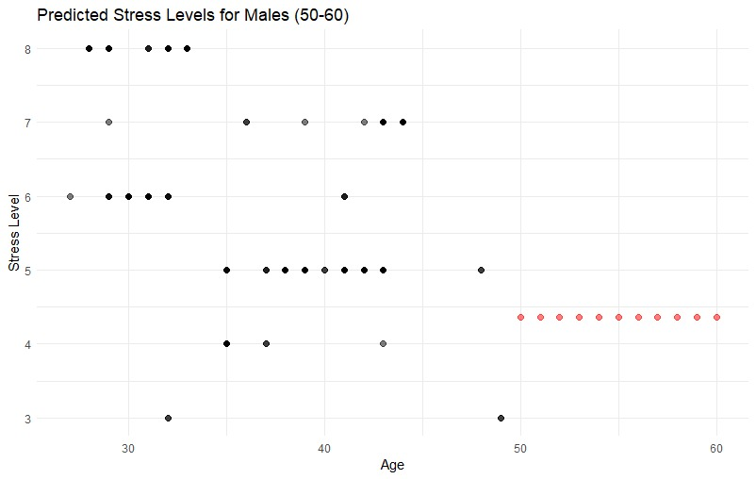
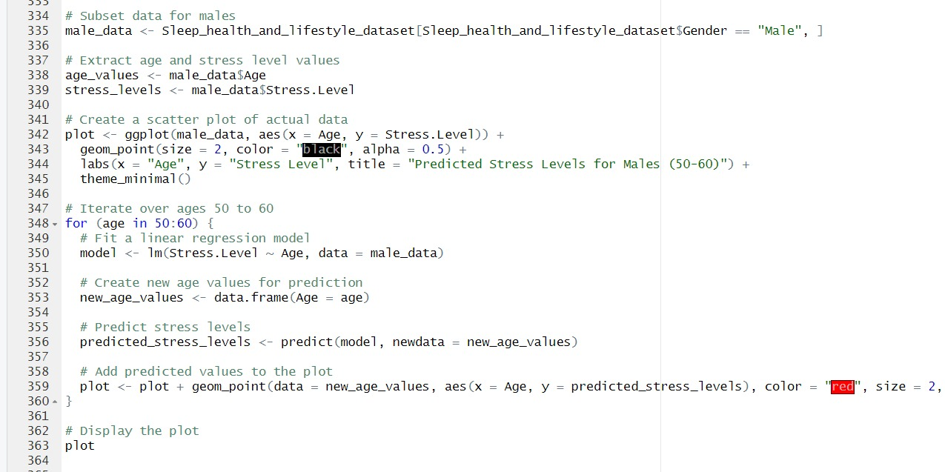
Stress Levels for Males

Slide 22
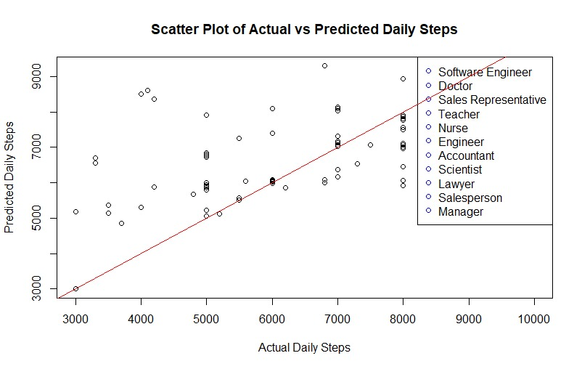
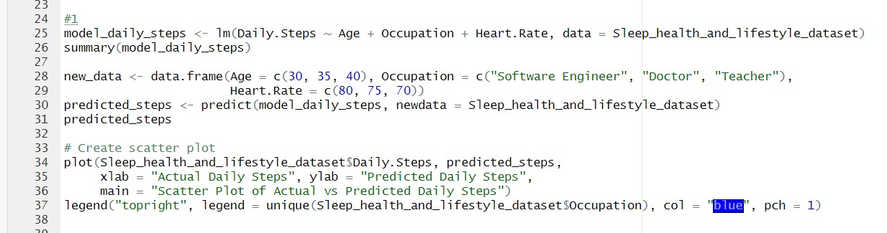
Actual Vs Predicted Daily Steps

Slide 23
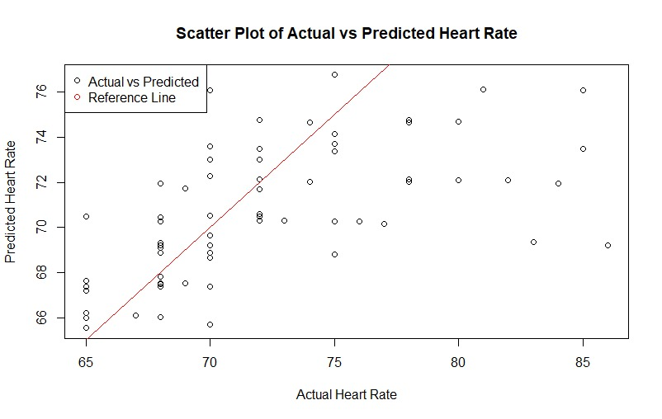
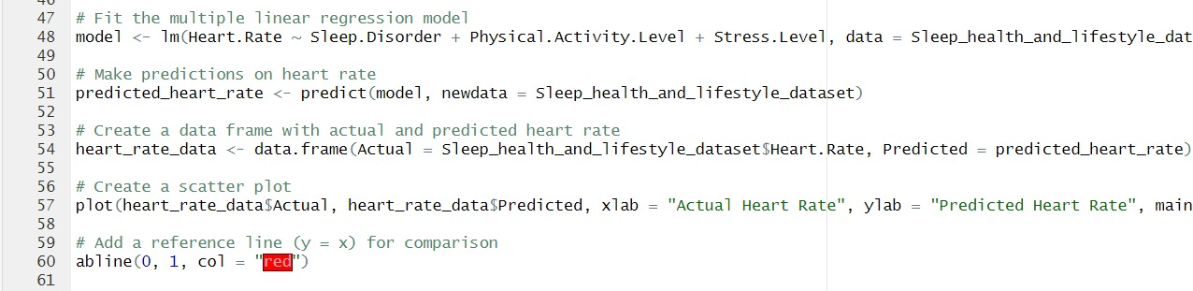
Actual Vs Predicted Heart Rate

Slide 24

Advantages
Early Intervention
Identifying Risk Factors
Resource Allocation
Limitation
Limited predictive power
Violation of assumptions
Lack of Dynamic understanding

Slide 25
CONCLUSION / FUTURE SCOPE
This model of analyzing and predicting the sleep quality heartrate of the persons could help in detecting the diseases at early stage.
As the professional institutions have the data of their employees if the institutions opt-in this model and provide the real time feed to this program, we can obtain the results very accurately and help to prevent the major cause which are affected due to sleep , stress level.
This program can be a game changing if opted by the Companies to look up for their employee's health, and it can be made more robust and effective by applying machine learning and qualitative data analysis techniques.

